Slide 1

Intel Edison
hello@hybus.net

Slide 2
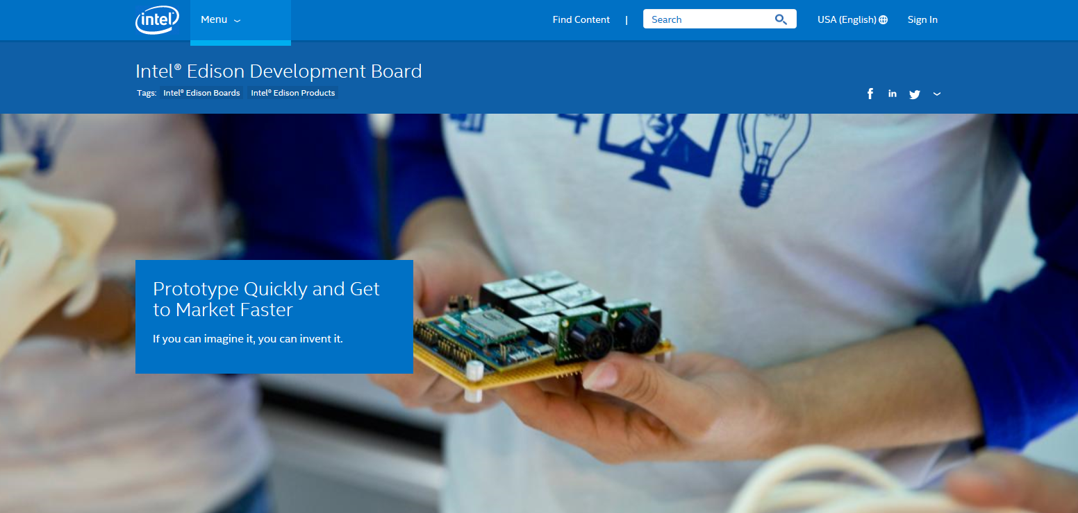
Intel Edison
기업제품의 Prototype 제작과 DIY를 목적을 개발 (60$~65$ 판매)
저전력 패키지 기반 Dual Core CPU와 Single Core Microcontroller탑재
http://www.intel.com/content/www/us/en/do-it-yourself/edison.html

Slide 3
feature
The Intel® Edison compute module is designed to lower the barriers to entry for anyone prototyping and producing IoT and wearable computing products.
Intel® Edison contains the core system processing and connectivity elements: processor, PMIC, RAM, eMMC, and Wi-Fi/BT.
It is not a self-contained, standalone device. Intel® Edison is a module that interfaces with end-user systems via a 70-pin connector.
The Intel® Edison compute module does not include any video input or output interfaces (MIPI CSI, MIPI DSI, HDMI, etc.).
Component | Description
Processor | Dual Core IA-32 @ 500 MHz, 32-bit Intel® Atom™ Processor Z34xx Series @ 100 MHz
RAM | 1 GB LPDDR3 POP memory (2 channel 32 bits @ 800 MT/sec)
Storage | 4 GB eMMC (v4.51 spec)
Power | TI SNB9024 power management IC, Power Input(3.15 to 4.5 V)
Wireless | Dual-band (2.4 and 5 GHz) IEEE 802.11a/b/g/n
Bluetooth | BT 4.0 + 2.1 EDR
Antenna | Dual-band onboard chip antenna or u.FL for external antenna
Connector | 70-pin Hirose DF40 Series (1.5, 2.0, or 3.0 mm stack height)
I/O | 40 general purpose GPIO which can be configured as: • SD card: 1 interface • UART: 2 controllers (one full flow control, one Rx/Tx) • I2C: 2 controllers • SPI: 1 controller with 2 chip selects • I2S: 1 controller • GPIO: Additional 14 (with 4 capable of PWM)
USB | 1 OTG controller
Clocks | 19.2 MHz, 32 kHz

Slide 4
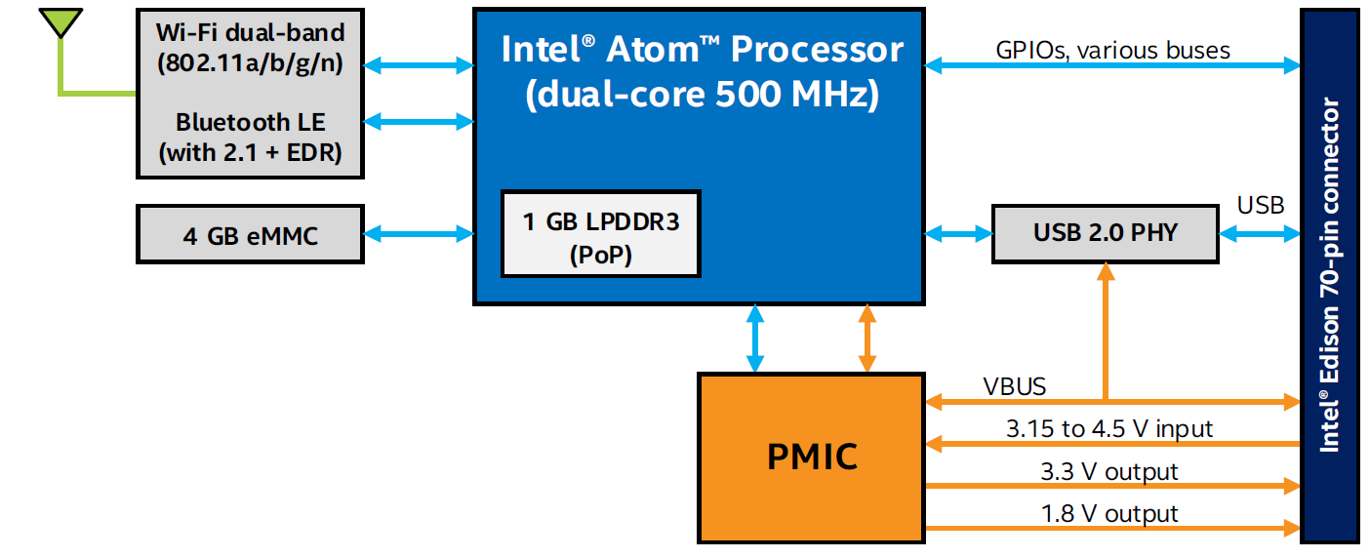
Block Diagram
source : http://www.arduino.cc “Products”

Slide 5
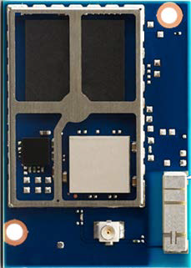
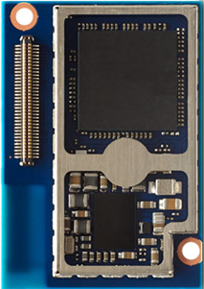
Module photos
Edison Top View
Edison Bottom View
eMMC
Processor and
DDR memory
Connector
(70pin I/O)
USB ULPI
Transceiver
Wi-Fi/BTLE
Module
Embedded
2.4/5.0GHz
antenna
PMIC
Antenna l
connector
source : http://www.arduino.cc “Products”

Slide 6
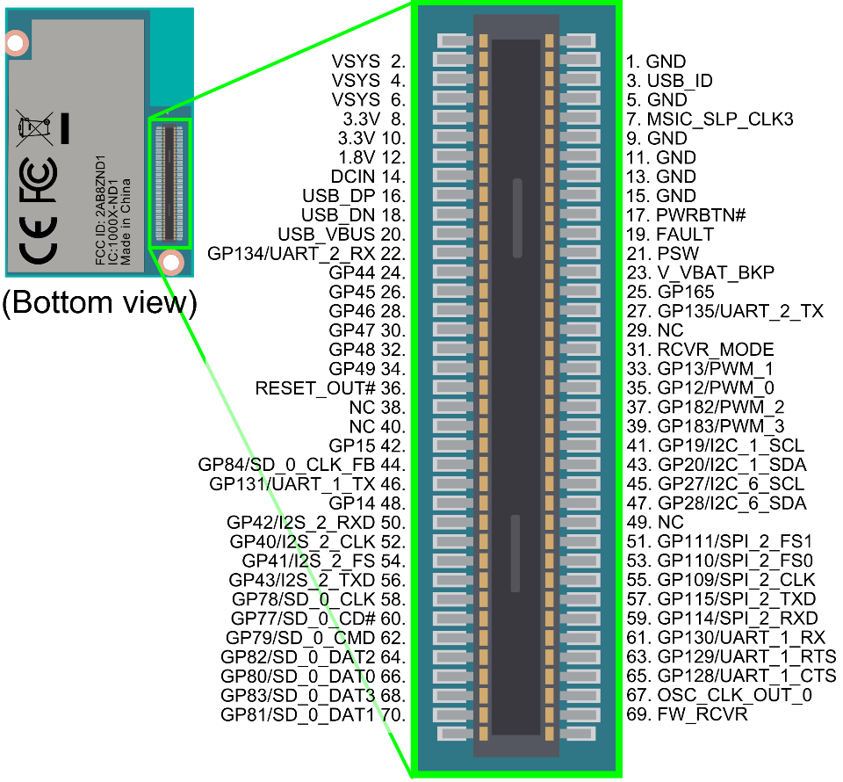
Pin Layout
source : http://www.intel.com/support/edison/sb/CS-035259.htm

Slide 7
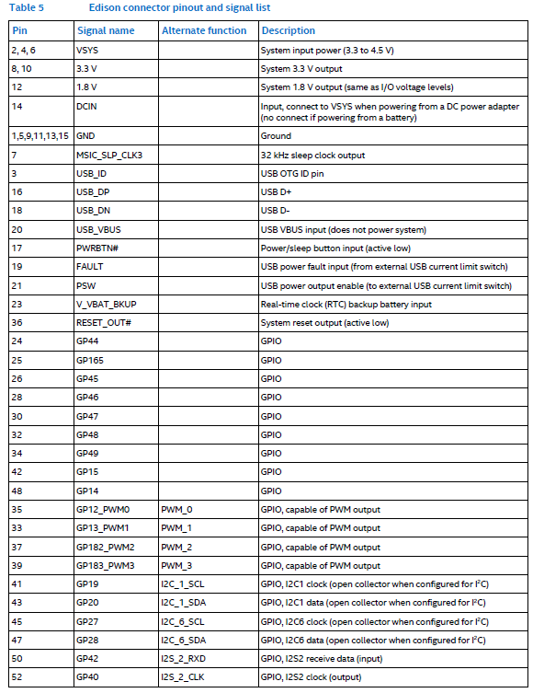
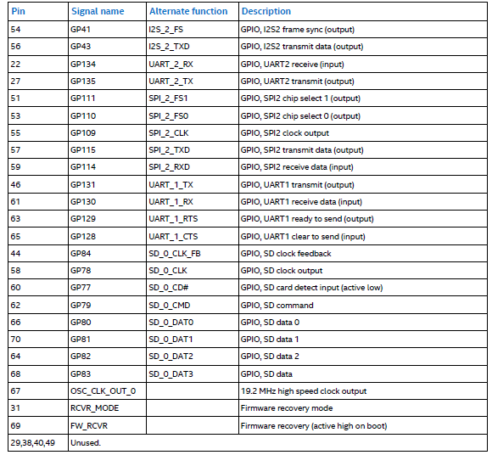

Slide 8
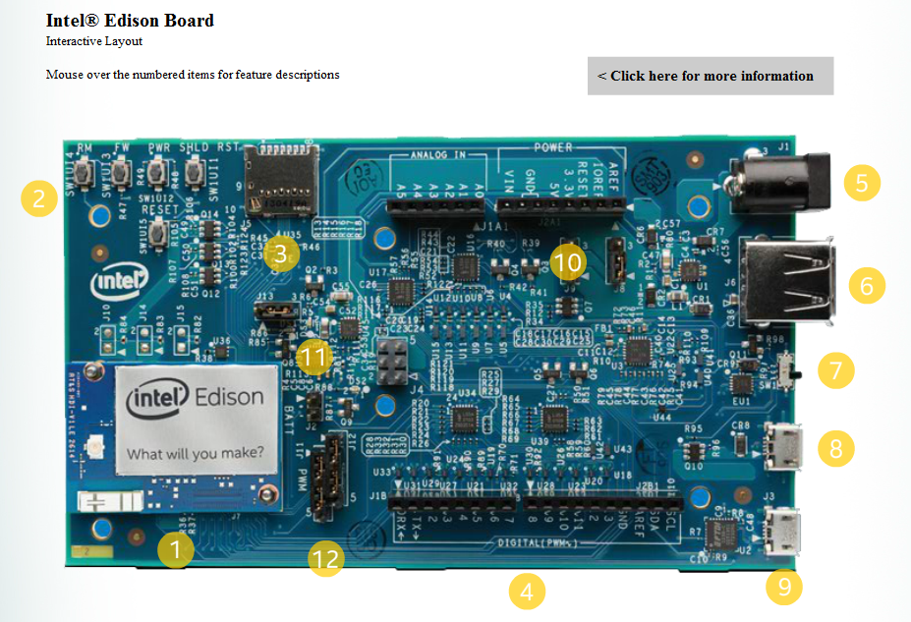
Edison Arduino Kit
Edison Compute Module
Button
Micro SD Card Slot
Arduino headers
External Power
USB Host
Power Switch
Micro USB
Micro USB
AREF and IOREF Select
Battery
PWM
source : http://www.intel.com/support/edison/breakout-bd/sb/CS-035653.htm

Slide 9
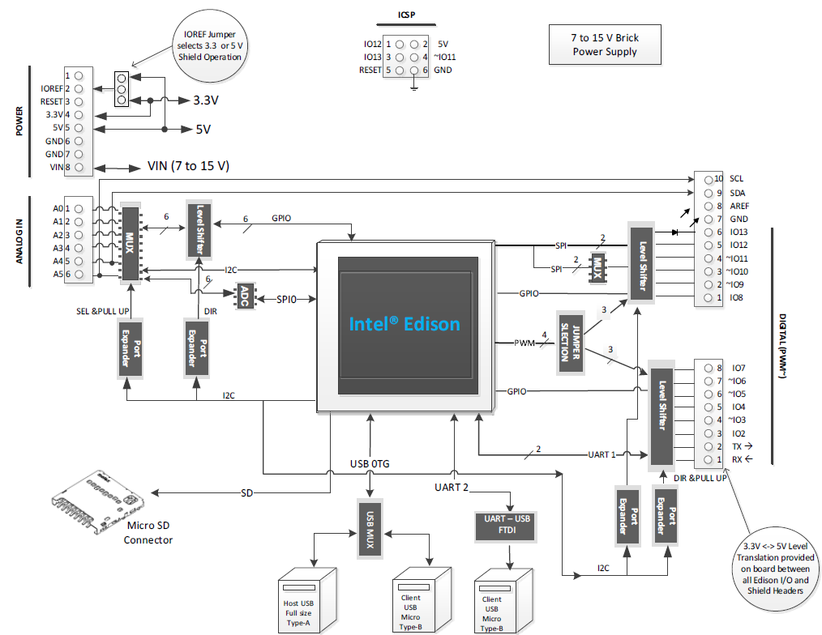
Edison Arduino Kit - Schematic

Slide 10
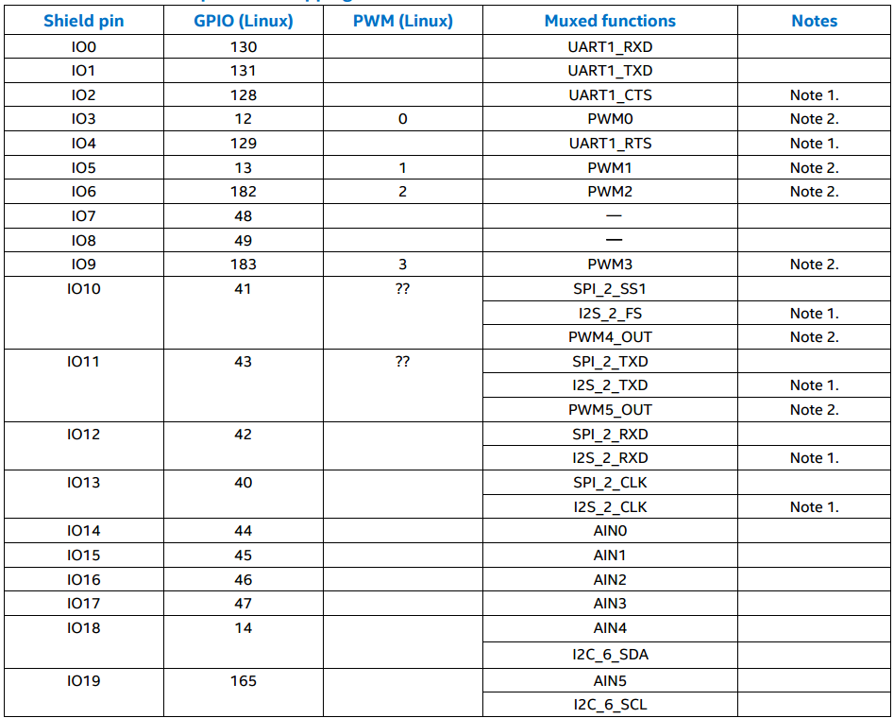
Shield pin GPIO mapping
Shield pin : Digital I/O pin number as per Arduino* Uno* pin numbering scheme.
GPIO (Linux) : The pin number assigned under Linux.
Muxed functions : Other signals available on this shield pin, as they appear on the schematic.
source : http://download.intel.com/support/edison/sb/edisonarduino_hg_331191007.pdf

Slide 11
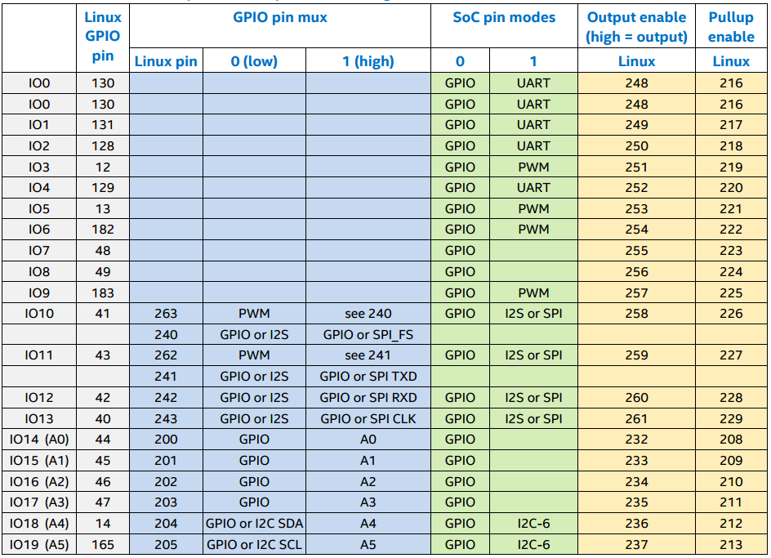
Pin function multiplexing control

Slide 12



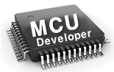

Software
IDE
Arduino IDE
Intel XDK
Eclipse
Wyliodrin
Firmware
Programming
Language
Arduino Sketch
C++
JavaScript
Node JS
C/C++
Python
Visual
Java Script
C/C++
Tools
Libraries
Arduino
Libraries
Intel XDK
ISS
Wyliodrin
MCU SDK
OS
Yocto Linux 1.6
RTOS

Slide 13
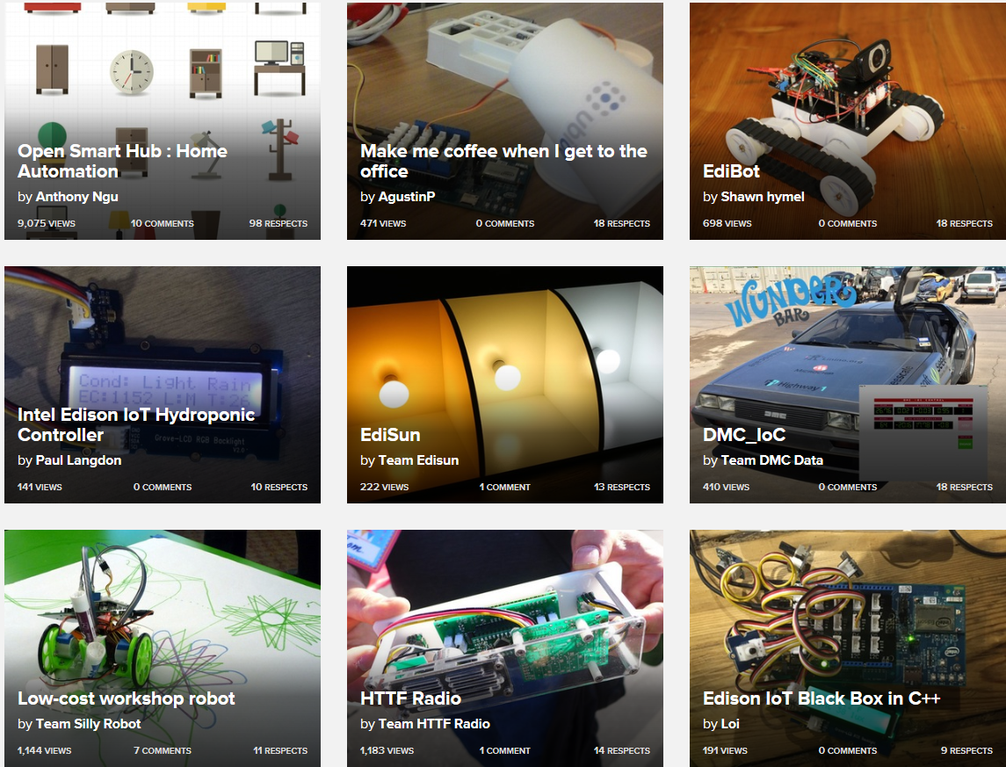
Projects built by makers powered by Intel Edison
https://www.hackster.io/intel-edison/projects
http://www.instructables.com/id/Intel/

